Slide 1
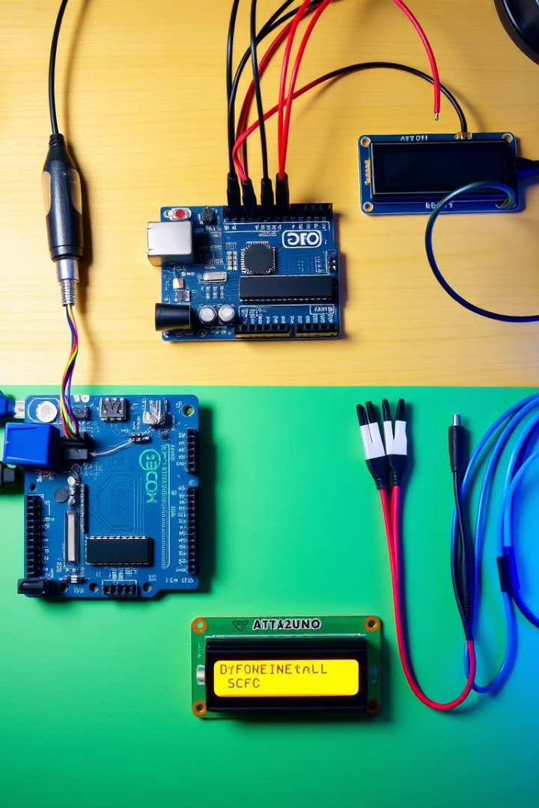
Distance Measurement with Ultrasonic Sensor
Explore distance measurement using an ultrasonic sensor and Arduino. This project integrates hardware components for real-time data. Applications include robotics, parking assistance, and obstacle avoidance.
Name:- Chirag Choudhary Roll No. 10
Name:- Manorath Ital Roll No. 19

Slide 2
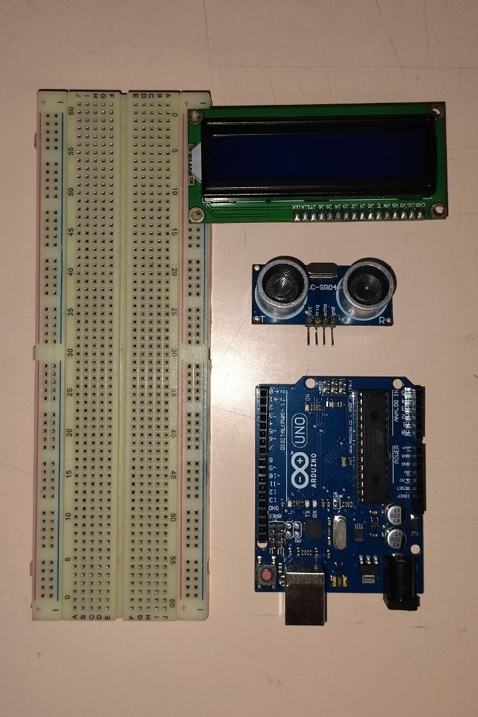



Understanding Ultrasonic Sensors
Ultrasonic sensors transmit and receive sound waves to measure distance. They typically operate at a frequency of 40 kHz. The distance is calculated using the time-of-flight principle.
Sound Waves
Time of Flight
Sensors transmit sound waves.
Measure time for wave return.
Distance
Calculated with a simple formula.

Slide 3
Essential Hardware Components
Arduino Uno
Ultrasonic Sensor
LCD (I2C)
Jumper Wires
ATmega328P microcontroller, 14 digital I/O pins, 6 analog inputs, USB interface.
HC-SR04, 2-400cm range, 5V power, 15mA current, 40kHz frequency.
16x2 LCD, I2C interface, backlight, 5V operation, address 0x27.
Male-to-male, 22 AWG, various colors, for breadboard connections.

Slide 4
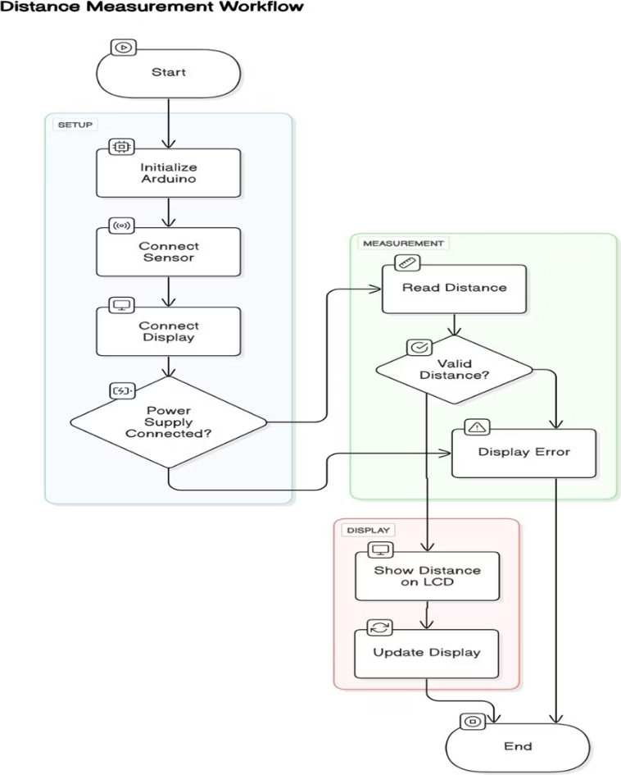
Flowchart:

Slide 5

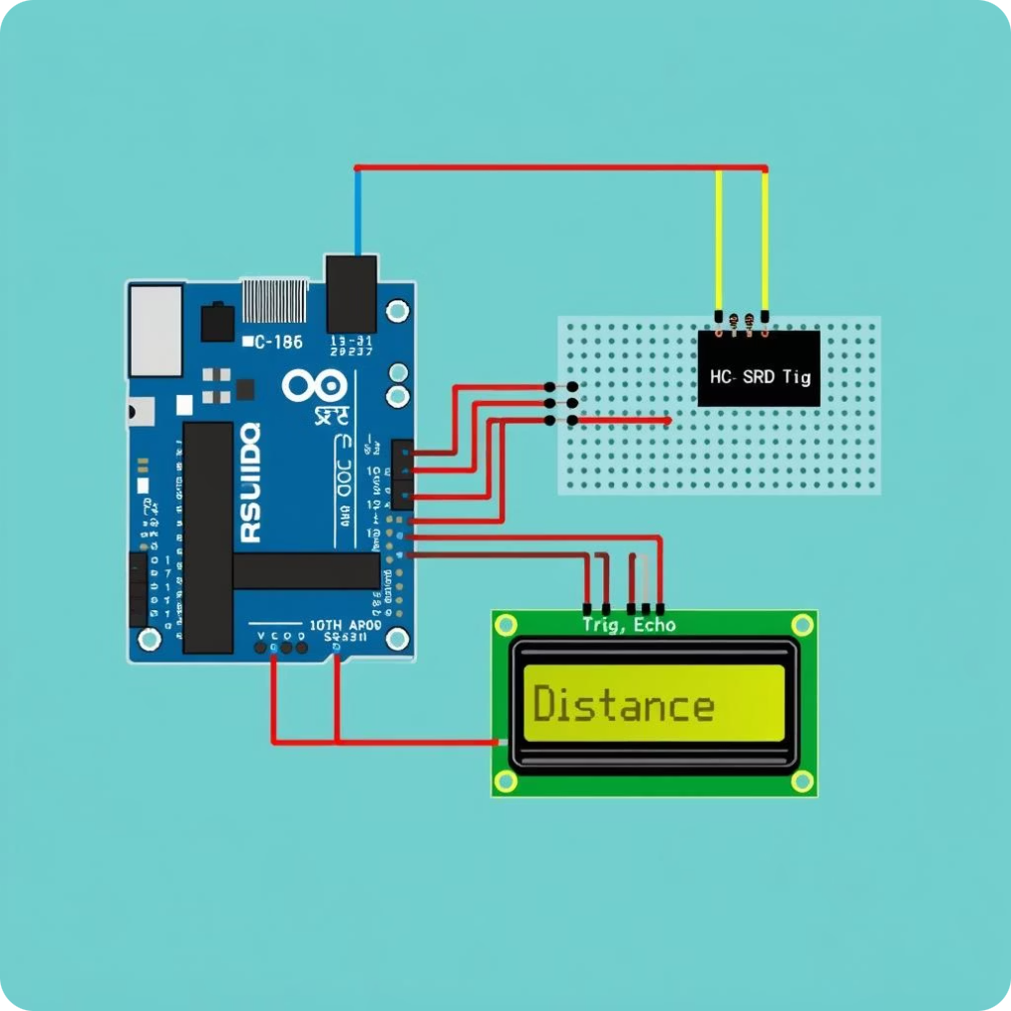
Circuit Connections
Connect the ultrasonic sensor and LCD to the Arduino. Use the provided pin configurations for proper functionality. Double-check all connections before powering on.
Ultrasonic Sensor
VCC to 5V
Trig to Digital Pin 9
Echo to Digital Pin 10
GND to GND
LCD (I2C)
SDA to SDA (A4)
SCL to SCL (A5)
VCC to 5V
GND to GND

Slide 6
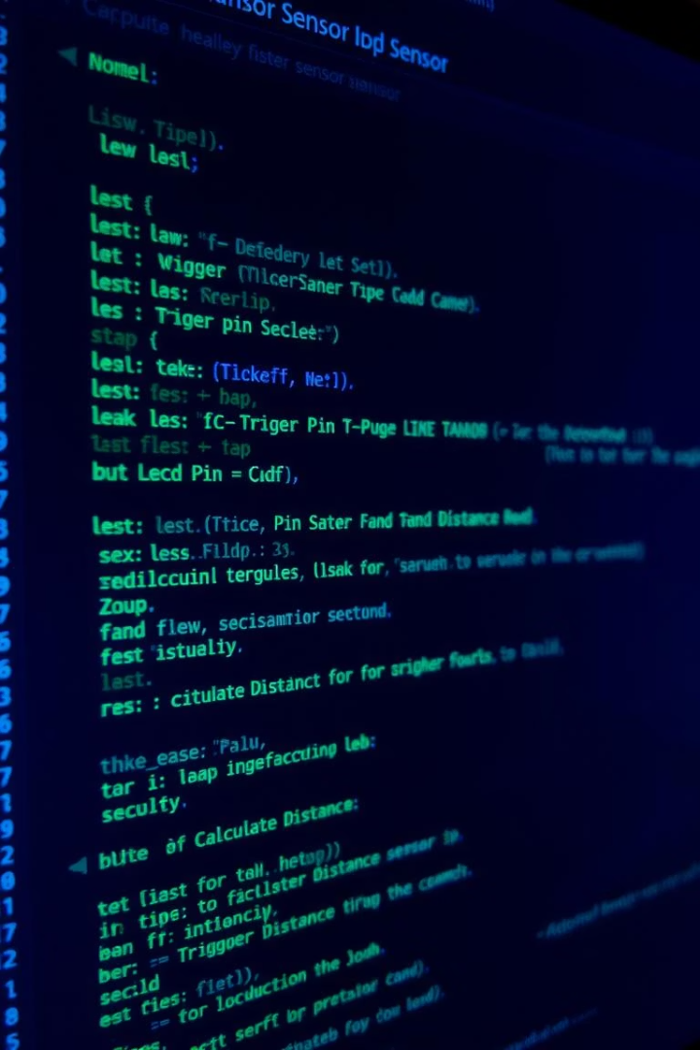




Arduino Code Structure
The Arduino code includes libraries and pin definitions. It initializes the LCD and triggers the ultrasonic sensor. Echo time is measured to calculate the distance.
Include Libraries
LiquidCrystal_I2C.h, Wire.h
Define Pins
Trig and Echo pins.
Initialize LCD
Set address and dimensions.
Trigger Sensor
Send a 10us pulse.

Slide 7
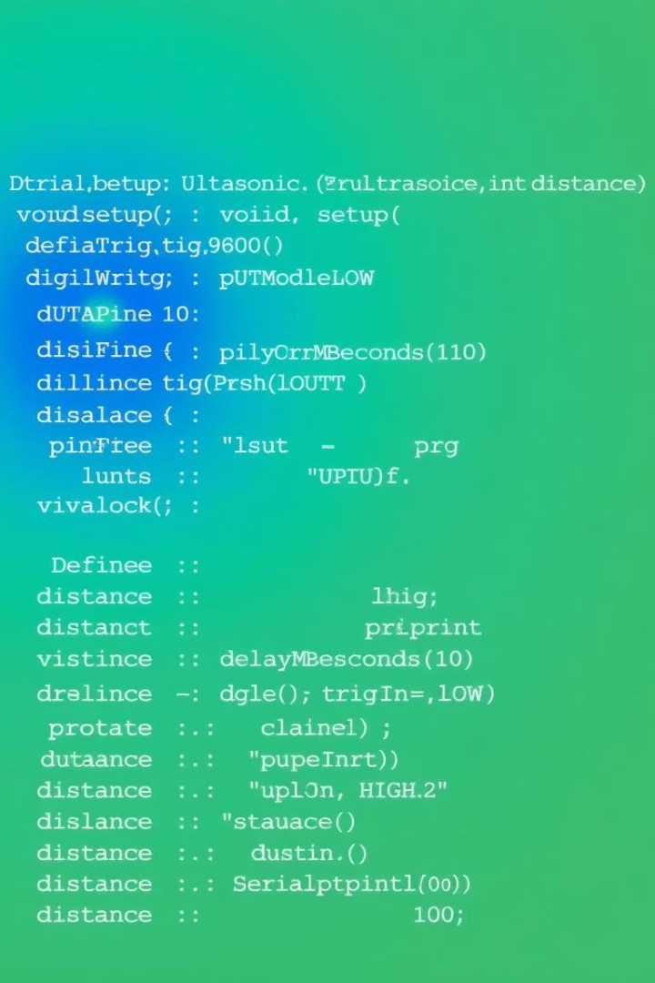
Code Implementation
This section details code snippets for triggering the sensor and reading echo time. LCD is updated to display distance readings. Make adjustments for accuracy and stability.
1
Trigger Sensor
digitalWrite(trigPin, LOW);
delayMicroseconds(2);
digitalWrite(trigPin, HIGH);
delayMicroseconds(10);
2
Read Echo Time
duration = pulseIn(echoPin, HIGH);
3
Display on LCD
lcd.print("Distance: ");
lcd.print(distance);

Slide 8



Calibration and Results
The sensor typically measures from 2cm to 400cm. Accuracy can be affected by temperature and surface type. Calibrate the code for optimal performance.
Controlled Lab
1
+/- 0.3 cm
Troubleshooting
2
Sensor triggering issues
Range
3
2cm to 400cm

Slide 9
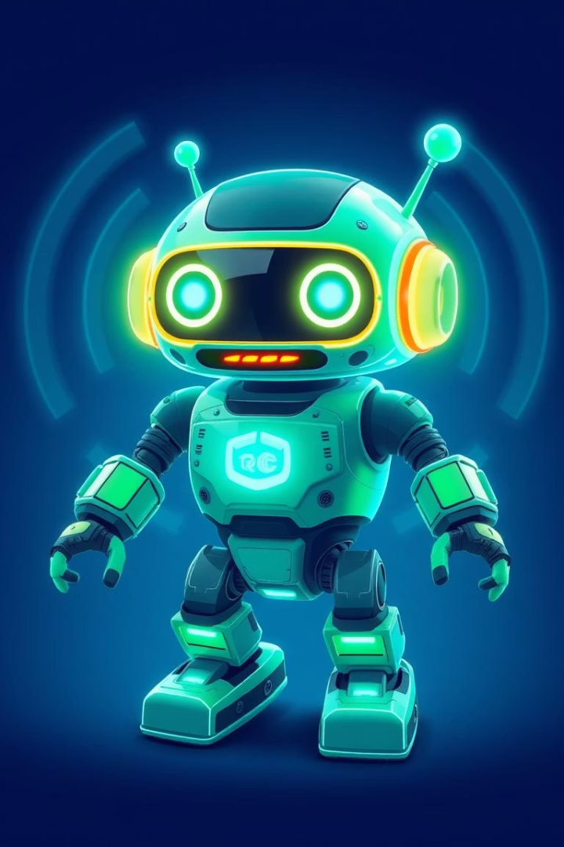



Applications and Enhancements
This project has applications in robotics and automation. Future enhancements include data logging and wireless communication. Integrate with a mobile app for remote monitoring.
Robotics
Automation
Remote Monitoring

Slide 10
References
Distance Measurement Using Ultrasonic Sensor and Arduino
Arduino Official Website
Ultrasonic Sensor HC-SR04 Datasheet

